Slide 1
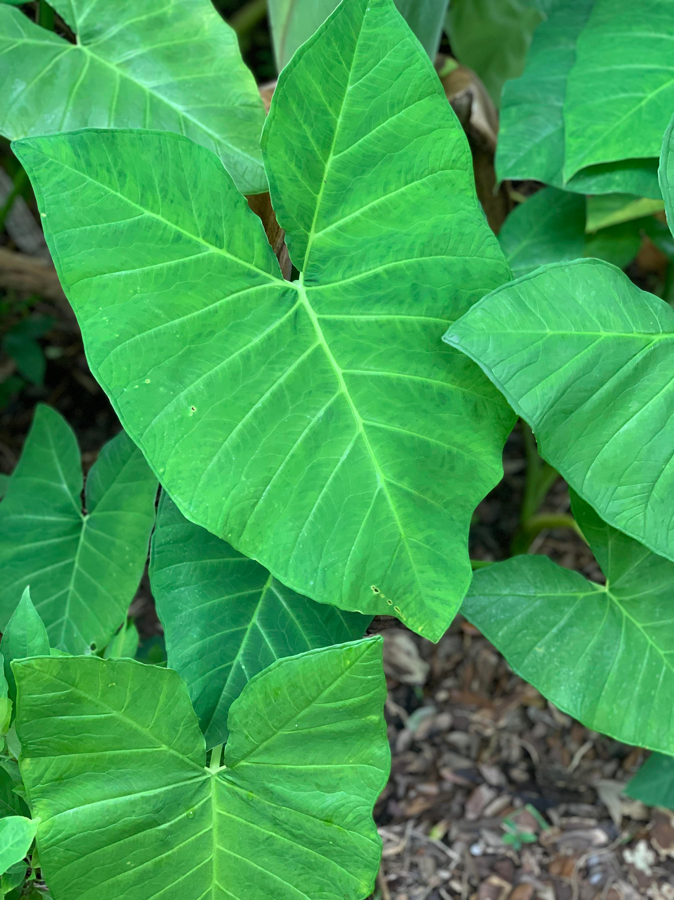
PLANT DISEASE DETECTION
Artificial Intelligence & Machine learning

Slide 2

PLANT DISEASE DETECTION
ARTIFICAL INTELLIGENCE
B.HARINI SRI (2103A52006)
B.ANVITHA (2103A52007)
M.VYSHNAVI (2103A52023)
Under The Guidance of
MR.D.RAMESH SIR
Asst.Professor
School of CS&AI
SR University

Slide 3
INTRODUCTION
Agriculture production in the Indian economy is more than just food. Today’s
agricultural land mass has grown so large that it has become an important part of its economy. In India, 60-70% of population relies on agriculture sector. Plant diseases often cause severe loss of vegetables and crops. Plant diseases can also affect human health by secreting toxic metabolites. The study of plant disease involves detection of visual patterns in the plants. Diagnosis of plant diseases is an important part of cultivation as failure will affect the quantity and quality of product and human health . There are various types of plant diseases caused by organisms like virus, bacteria and fungus. An automated disease identification process can be helpful in identifying plant pathology at an early stage.

Slide 4
PROBLEM STATEMENT:
Automatic detection of plant diseases is an essential research topic as it may prove benefits in monitoring large fields of crops, and thus automatically detect the symptoms of diseases as soon as they appear on plant leaves. The goal of this project is to classify the leaves as healthy and unhealthy where the leaves in healthy represents those without any disease and the leaves in unhealthy represents the presence of disease.

Slide 5
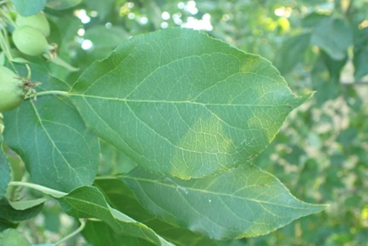
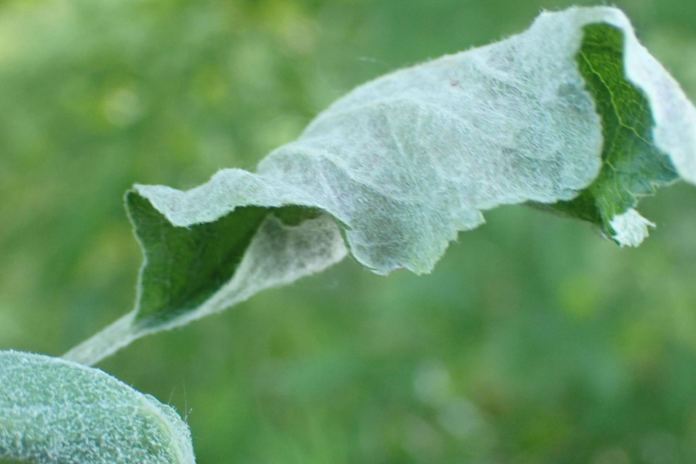
DATA SET
https://drive.google.com/drive/folders/1PPdNtL2oFoH-GvFK5ILYA2di_TWRYhnV?usp=share_link

Slide 6
LEARNING MODEL:
SUPERVISED LEARNING

Slide 7
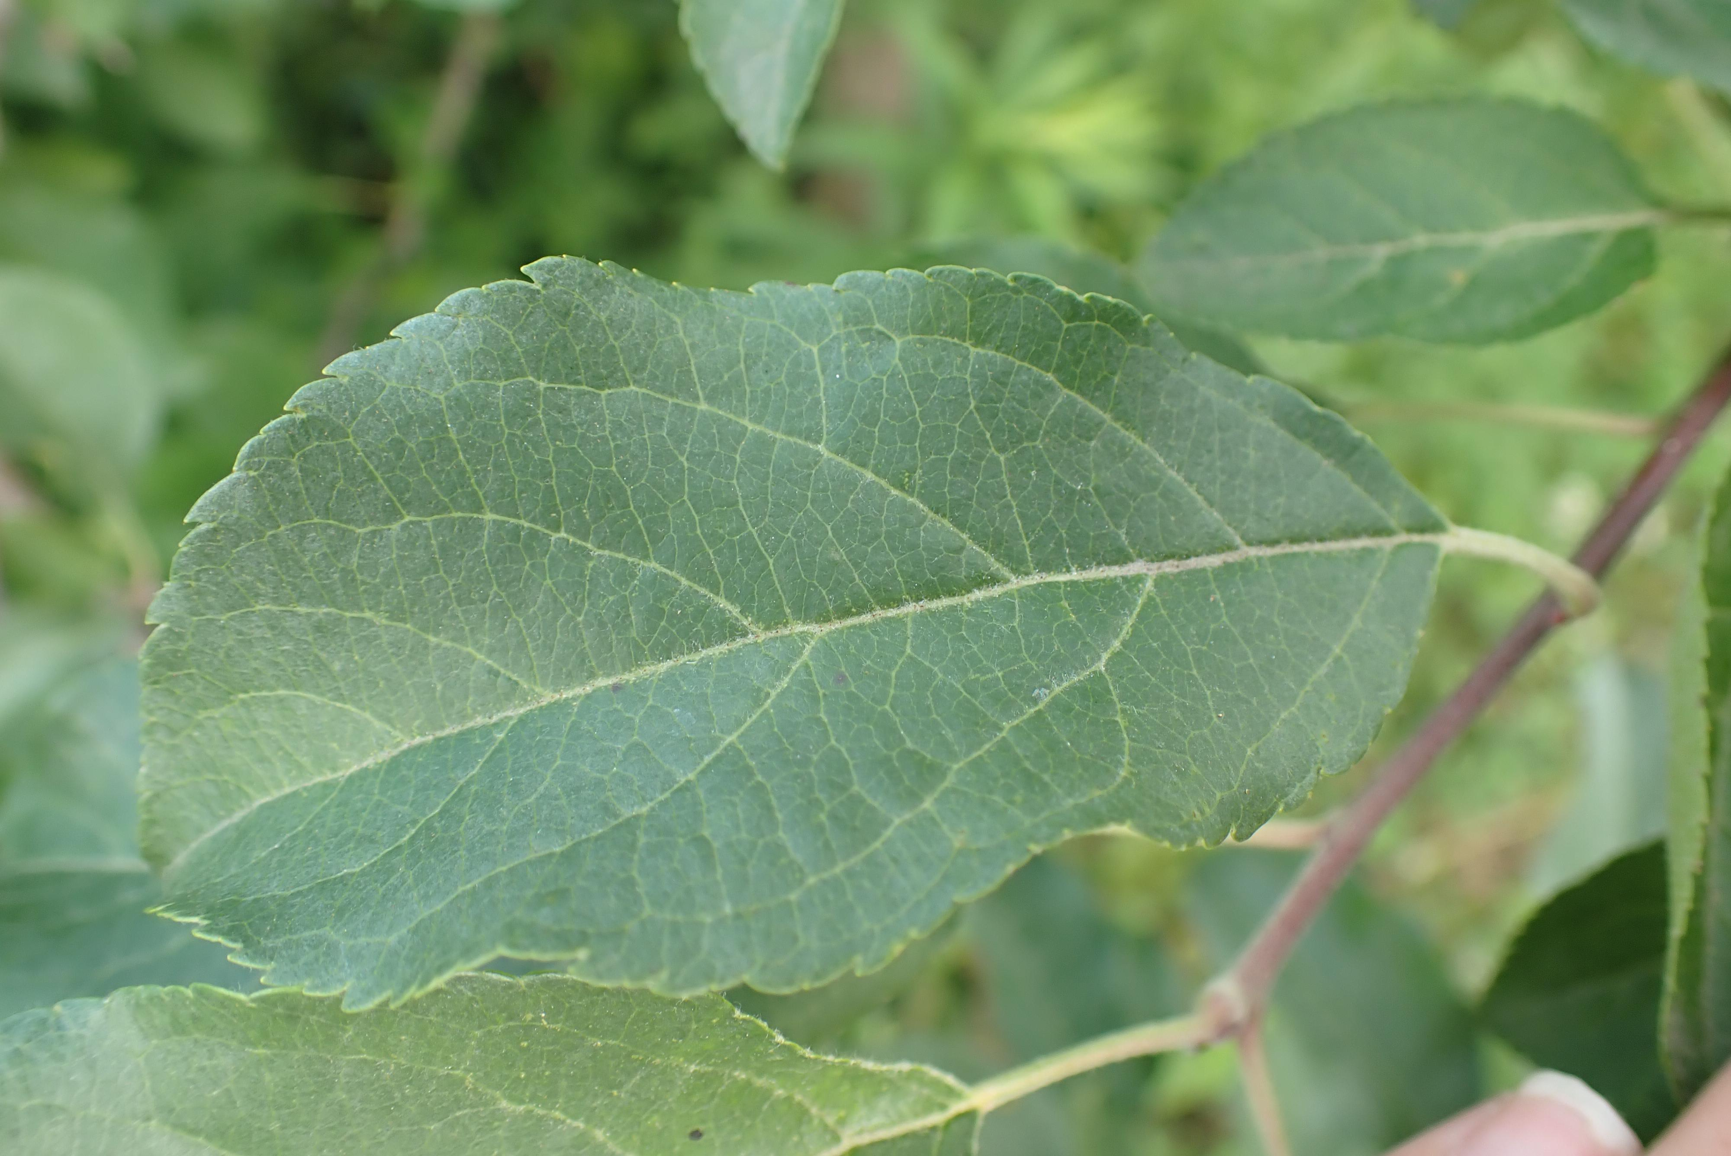
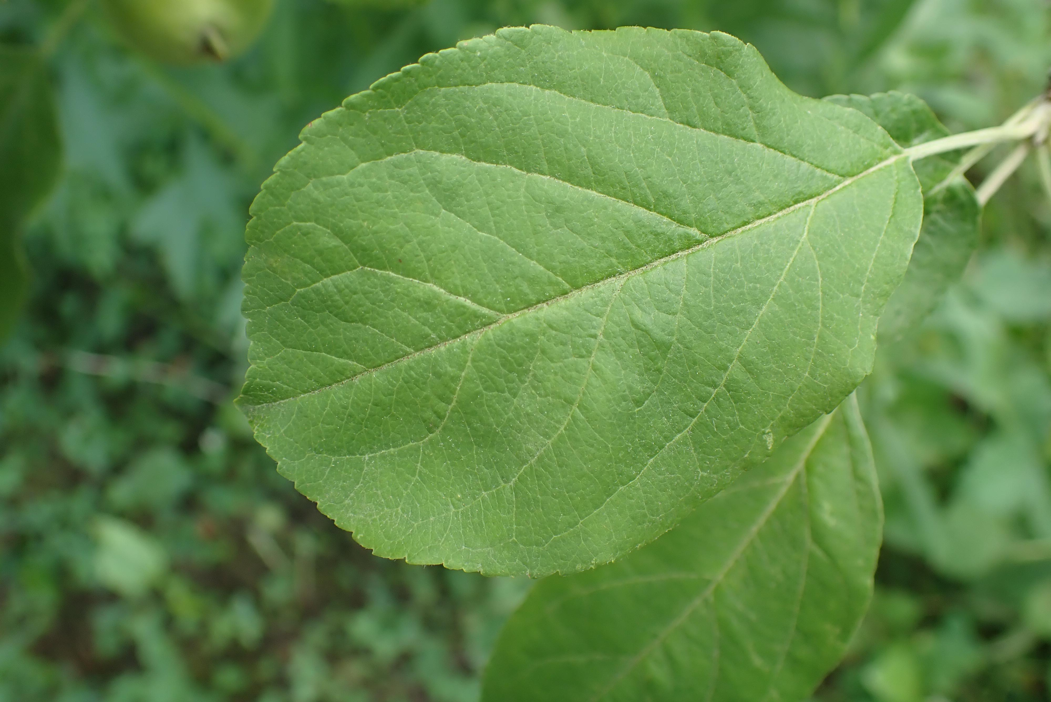

HEALTHY IMAGES:

Slide 8
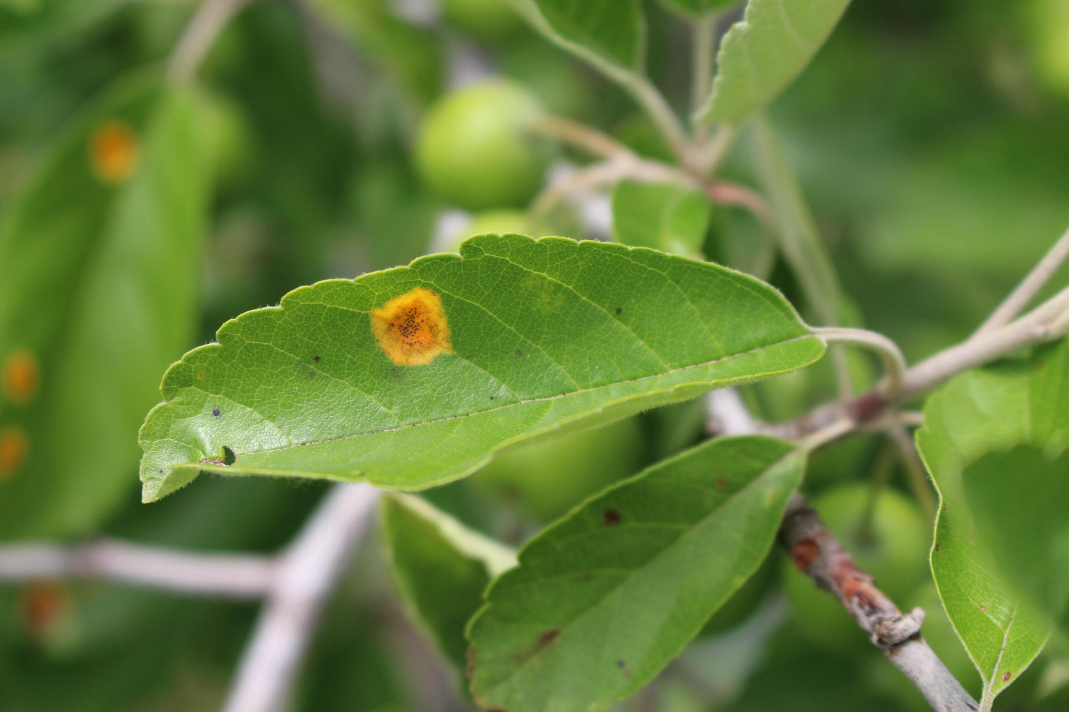
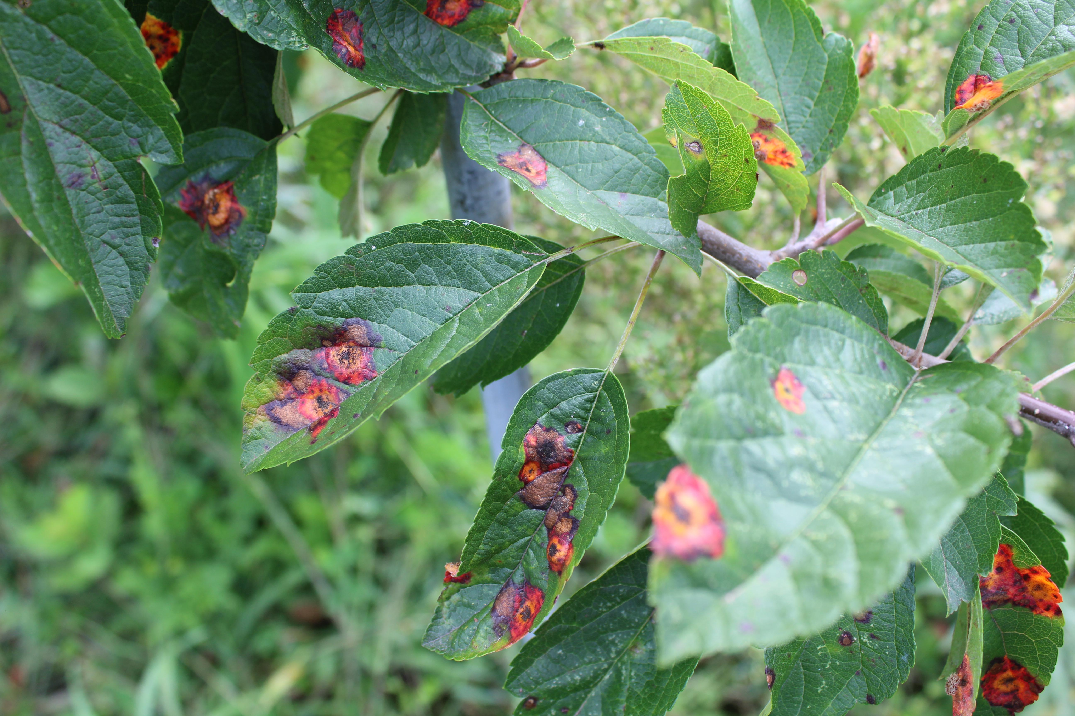
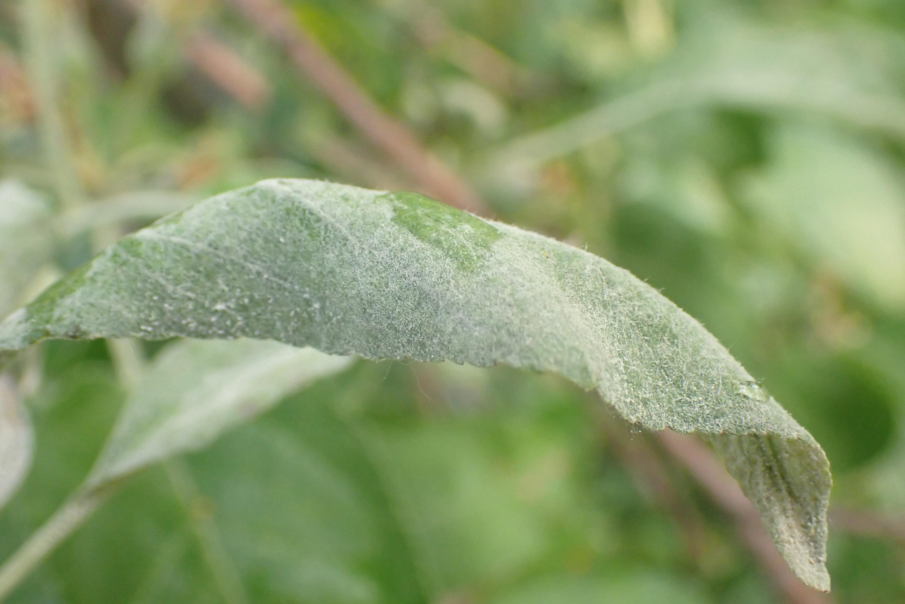
UNHEALTHY IMAGES:

Slide 9
IMAGE PROCESSING AND OPEN CV
Data conversion from image data to an array is an important preprocessing step in many machine learning and computer vision applications. When working with images, we typically represent them as matrices of pixel values. However, machine learning algorithms require numerical data in form of arrays or tensors to be able to process the data effectively.
One common method of converting image data to an array is by using opencv, an open-source computer vision library. Opencv provides a range of functions to load, process and manipulate image data in a variety of formats. To convert an image to an array using opencv, we first load the image using the imread() function. This function reads the image and returns a numpy array representation of the image in bgr format. We display the image by using pyplot() module we use imshow function from it.

Slide 10
OpenCV for Python provides a simple and efficient API for performing various image processing operations, such as image filtering, thresholding, and edge detection.
OpenCV for Python is a powerful tool for image and video processing that can be used for various applications in computer vision and machine learning. Its easy-to-use API and compatibility with popular Python libraries make it a popular choice among developers and researchers.

Slide 11
CONCLUSION
Even though there are various methods for detecting and classifying plant diseases using automatic or computer vision, research into this field has been lacking. In this project disease detection and identification is done by using an image processing and machine learning algorithms like Knn, SVM, Logistic regression, Decision tree. We have made a machine learning model that classifies the leaves in the dataset into healthy that represents disease free leaves and unhealthy which represents the presence of disease in the leaves.

Slide 12
THANK YOU

